Slide 1
Web Engineering
Lecture 11
HTML Headings & Paragraphs
Zulfiqar Ahmad
Lecturer
Department of Information Technology
Hazara University Mansehra
zulfiqarahmad@hu.edu.pk

Slide 2

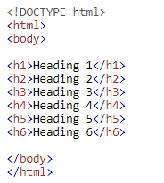
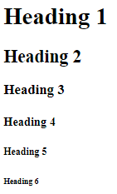


Slide 3




Slide 4

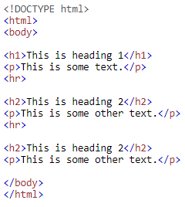
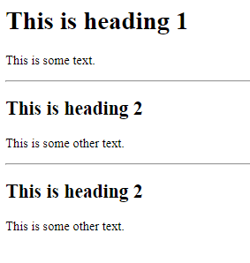

Slide 5

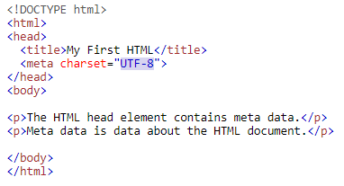

Notes:
UTF-8 is a variable width character encoding capable of encoding all 1,112,064 valid code points in Unicode using one to four 8-bit bytes
Unicode Transformation Format

Slide 6


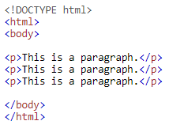
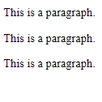

Slide 7

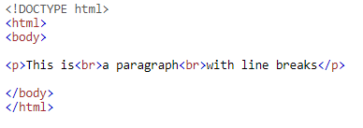


Slide 8

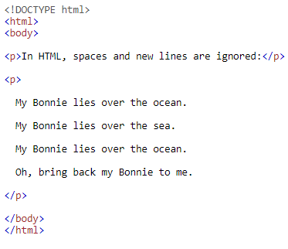


Slide 9

